Slide 1







SmartBookTM Ltd.
智言字語
The gamified, AI-driven multi-lingual ebook platform!
Notes:
圖片來源：
說故事 http://www.elitian.hk/story-telling-course
聽 http://reader.roodo.com/lhyun123/archives/1263966.html
說 http://wk706.pixnet.net/blog/post/53123413-%E6%98%9F%E6%9C%9F%E5%85%AD%E5%89%B5%E5%88%8A%E8%99%9F%E2%94%80706(%E6%88%91%E6%9C%89%E8%A9%B1%E8%A6%81%E8%AA%AA)
書 https://edonix.it/book-icon-91379-3/

Slide 2


Current problems faced by foreign Chinese learners
Our platform solves all these problems!
Learning a new language is tedious, and traditional learning forms lack immediate feedback
→ Create an interactive learning app with AI technology to assist users with reading, listening and speaking in real-time.
→ A large variety of illustrated and interactive ebooks with subjects tailored to individual interests and abilities.
Unattractive textbook formats present a boring wall of text
→ Foreign parents could accompany and assist their children to read with bilingual books.
Insufficient market supply of bilingual books and materials for CSL learners
Initially, SmartBook™ will offer Chinese and English bilingual eBooks. Gradually, our platform can support multiple languages, making language learning more lively and efficient.
Figure source: http://www.sohu.com/a/243328187_418353
Notes:
（加入）Our 电子书店can serve many different kinds of learners. We’ll start our first product that helps people to learn Chinese as a second language
資料來源：
http://joyoflanguages.com/when-language-learning-gets-boring-language-goals-december-2016/
圖片來源：
學漢語 http://www.sohu.com/a/243328187_418353
Our solutions to the 3 problems - sam
课本单一乏味，欠缺互动 - 电子书为儿童提供了一个字典功能来搜索单词(读)，也可以自行读给孩子（听），学习母语使用者说话的方式提供使用者与母语使用者比较的反馈 (说)
缺乏有趣课外阅读书籍
CSL学习者发现很少有休闲阅读中文书籍是他们感兴趣的(ref)
我们团队中的专家[CSL老师]了解CSL学习者的需求，他们将制作许多有趣的故事和非小说类书籍
根据已通过版权的书籍，我们将制作大量的书籍。它将为读者提供一个可供选择的汇总，从而能够找到他们感兴趣的书籍
市面上缺乏适合的双语书籍
父母想知道他们的孩子在学习什么，双语书籍能够使父母对子女学习汉语感到放心
利用文本和图像处理技术，我们将能够根据已通过版权的中文/英文书籍大量制作许多双语书籍

Slide 3







AI-driven eBook Platform
Initial Target Users: Foreign students studying Chinese as a second language.
Future: Gradually, our platform would develop multi-language capabilities for students who wish to learn any new language.
Users will log in to the online platform and be presented with eBook purchasing options tailored to their preferences and abilities.
All eBooks possess audio functions with native pronunciation for listening.
"Speech recognition" capabilities allow users to read book out loud and receive real-time pronunciation feedback. This will also be tracked and used in the engine to tailor future selections.
Figure source: www.flaticon.com
Notes:
圖片來源：
www.flaticon.com

Slide 4

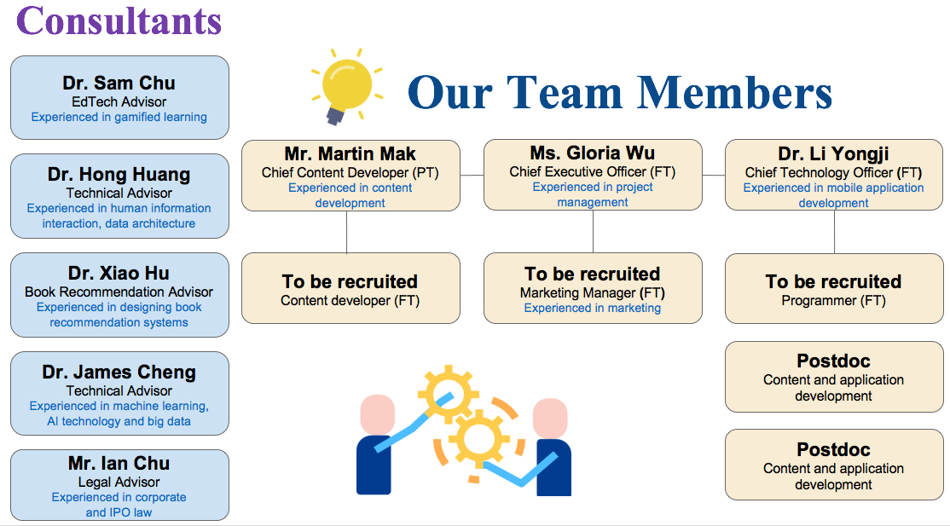
Experienced Team to Execute Vision

Slide 5
Product Features and Functions
1. Gamification of language training
Foster constructive competition in learning
Intrinsically motivate users for effective learning (age-appropriate rules -> challenging but manageable to encourage status advancement)
Monitor ability progress (e.g. progress bar)
2. AI-driven e-learning platform
Speech recognition – pronunciation feedback and correction, tracking of user speech proficiency
Monitor reading experience - Eye tracking, page duration
Facial expression analysis – Track user emotion and strain when reading and speaking
3. Personalized services driven by big data
Establish user profiles based on interests and preferences
Create personalized learning progress ladder that forms a series of achievable challenges to avoid user frustration and maintain engagement to drive forward progress
4. Book recommendation and evaluation system
Suggest suitable levels of books for readers according to users’ reading and speech training results
Recommend new books to users based on the book ratings of readers with similar profiles
Notes:
The artificial intelligent system is big data driven, and collect multi-dimensional data sources: for example: text, images, voice, video including facial features, eye movements, page duration time).
The infrastructure of cumulative data feedback loop offers a mechanism that can continuously optimize content, dynamically deliver personalized content, evaluation that can store in the cloud anywhere and any time).
*****This slide can be removed if out of space.**** (Hong)
References:
语音识别：
Chan, W., Jaitly, N., Le, Q., & Vinyals, O. (2016, March). Listen, attend and spell: A neural network for large vocabulary conversational speech recognition. In Acoustics, Speech and Signal Processing (ICASSP), 2016 IEEE International Conference on (pp. 4960-4964). IEEE.
Ono, Y., Onishi, A., Ishihara, M., & Yamashiro, M. (2015). Voice-Based Computer Mediated Communication for Individual Practice to Increase Speaking Proficiency: Construction and Pilot Study. InLearning and Collaboration Technologies (pp. 115-123). Springer, Cham.
面部表情 the reference has listed:
Sariyanidi, E., Gunes, H., & Cavallaro, A. (2015). Automatic analysis of facial affect: A survey of registration, representation, and recognition. IEEE transactions on pattern analysis and machine intelligence, 37(6), 1113-1133.
Ming, Y. (2015). Robust regional bounding spherical descriptor for 3D face recognition and emotion analysis. Image and Vision Computing, 35, 14-22.
页面时间： Gwizdka, J., & Bilal, D. (2017, March). Analysis of children's queries and click behavior on ranked results and their thought processes in google search. In Proceedings of the 2017 conference on conference human information interaction and retrieval (pp. 377-380). ACM.
引导式学习：
Goldie, A. D. (2011). CHATTER: a spoken language dialogue system for language learning applications (Doctoral dissertation, Massachusetts Institute of Technology).
Chali, Y., & Golestanirad, S. (2016). Ranking automatically generated questions using common human queries. In Proceedings of the 9th International Natural Language Generation conference (pp. 217-221).
'
监控学习：
Gan, B., Menkhoff, T., & Smith, R. (2015). Enhancing students’ learning process through interactive digital media: New opportunities for collaborative learning. Computers in Human Behavior, 51, 652-663.
應用科技資料
Source: Smith, 2004

Slide 6
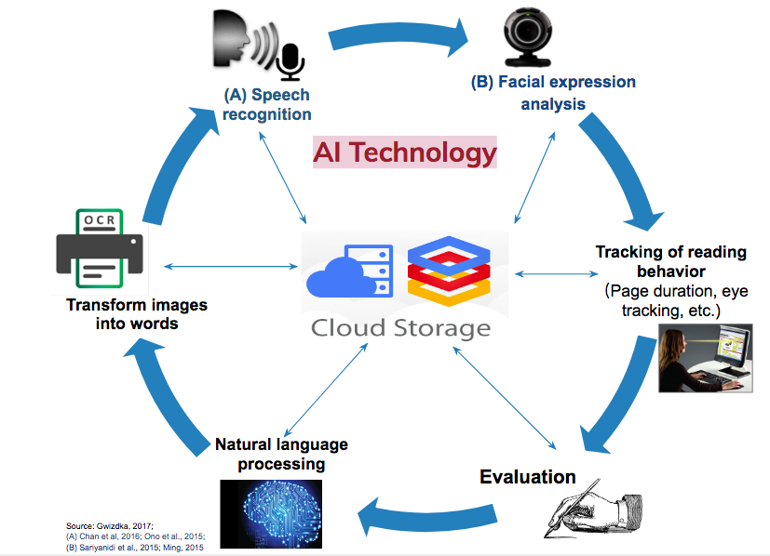


Cumulative Data Feedback Loop
Continuous content optimization
Personalized content
Evaluation anywhere anytime
Book Search & Recommendation: personalized algorithm
Google Cloud Machine Learning
NLP (Dialogue System & Analysis):
Understand the reader's request and return the books needed by the reader
TensorFlow Lite:
(run inside mobile app) adapt expert learning models to real-time detect reading difficulty and provide necessary intervention and help
1. Big Data
User profiles (facial / emotional / behavioural recognition and prediction)
NLP analysis on user behaviour/preferences
2. Content
Thousands of free-IP works
Customized Patent:
Leader board
Ranking algorithm
Speech Training
Pronunciation
Personalized recommendation

Slide 7

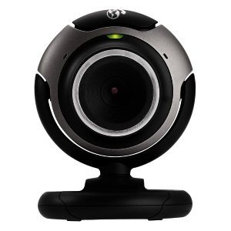




(B) Facial expression analysis
(A) Speech recognition
Personalized reading recommendations
Content development: words, illustrations and multi-media
Tracking of reading behavior
（Page duration, eye tracking, iris dilation etc.)
Transform images into words
Automated tests: · reading speed
・reading progress
・reading difficulty
Adjustment of animated context and levels (based on level of literacy)
Evaluation
Natural language processing
Source: Gwizdka, 2017;
(A) Chan et al, 2016; Ono et al., 2015;
(B) Sariyanidi et al., 2015; Ming, 2015
Notes:
大数据驱动 （智能系统全方位收集 多维度的数据来源：例如：文字，图像，语音，面部特征，眼动，页面停留时间）
累积数据反馈闭环 （形成数据反馈闭环可以不断优化内容，动态推送个人化的内容，和更精准的进行阅读测评）
语音识别
Chan, W., Jaitly, N., Le, Q., & Vinyals, O. (2016, March). Listen, attend and spell: A neural network for large vocabulary conversational speech recognition. In Acoustics, Speech and Signal Processing (ICASSP), 2016 IEEE International Conference on (pp. 4960-4964). IEEE.
Ono, Y., Onishi, A., Ishihara, M., & Yamashiro, M. (2015). Voice-Based Computer Mediated Communication for Individual Practice to Increase Speaking Proficiency: Construction and Pilot Study. In Learning and Collaboration Technologies (pp. 115-123). Springer, Cham.
---------------------------------------------------------------------------------------------------------------------------------------------------------------
面部表情 the reference has listed:
Sariyanidi, E., Gunes, H., & Cavallaro, A. (2015). Automatic analysis of facial affect: A survey of registration, representation, and recognition. IEEE transactions on pattern analysis and machine intelligence, 37(6), 1113-1133.
Ming, Y. (2015). Robust regional bounding spherical descriptor for 3D face recognition and emotion analysis. Image and Vision Computing, 35, 14-22.

Slide 8

Source of Initial Platform Content
When books’ copyright protection expires, literary and artistic works can be enhanced and reproduced.
Many classic children's books are valuable materials for education and reproduction.
Examples of genres
•Classical Western Children's Literature
•Traditional Chinese Folktales
Notes:
Classical Western Children's Literature
(http://elearning.ntcu.edu.tw/base/10001/course/10010322/content/public/history.pdf)
•Traditional Chinese Folktales
(https://wenku.baidu.com/view/2c27532600f69e3143323968011ca300a6c3f629.html)

Slide 9
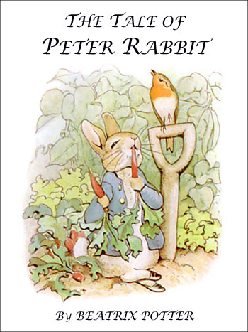
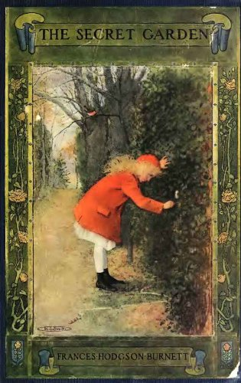

Public Domain Content Remains Valuable
Each book is priced around US$1-7 (e-book) / US$6-28 (printed book)
eBooks global daily sales has surpassed printed books
→ Large business value
 | (A) The Tale Of Peter Rabbit | (B) The Secret Garden | (C) The Velveteen Rabbit
Daily sales of eBooks | 300 | 400 | 120
Daily sales of printed books | 200 | 300 | 100
Year of publication | 1,901 | 1,911 | 1,922
Number of publisher | 796 | 2,849 | 124
Amazon sales’ rank | 5.0/5.0 | 4.5/5.0 | 5.0/5.0
sources: (A)http://www.cybercrayon.net/readingroom/books/bp-peterrabbit/peterrabbit.html
(B)https://www.amazon.com/Secret-Garden-Frances-Hodgson-Burnett-ebook/dp/B005GWF2ZK
(C)https://www.oompa.com/products/the-velveteen-rabbit-plush-toy
Amazon sale’s rank http://www.salesrankexpress.com/
Amazon sale’s caculator https://www.tckpublishing.com/amazon-book-sales-calculator/

Slide 10










Application of technology and content production flow chart
eBook content creation, typesetting, AI content handling and evaluation
Interactive images, motion pictures and AR interaction
TensorFlow (google cloud machine learning engine): Analyze reading behavior (duration/ face expression/ eye movement, etc.) with book content , establish a user profile, and provide personalized recommendations based on readers' interests (illustration and text recommendation ).
Images
Extraction of images and text
Cumulative Data Feedback Loop allows continuous content optimization and personalized content
Text
NLP (Dialogue System): Understand the reader's request and return the books needed by the reader
Typesetting, adaptation for touch screen and webpage formats
AI NLP for Content analysis
Analysis for chapters and paragraphs
Examples of answers
TensorFlow Lite (run inside mobile app): adapt expert learning models to real-time detect reading difficulty and provide necessary intervention and help.
Source: Amin (2015), Balyan, Mccarthy, & Mcnamara (2017), Gupta, Jacobson, & Garcia, 2007, Hicsonmez, Samet, Sener, & Duygulu (2017)
Figure source: http://www.51freeware.com/?tag=%E6%96%87%E5%AD%97%E8%AF%86%E5%88%AB
Notes:
Classical ebook pictures and text were captured via OCR techniques,
Apply Pristma, Maya, Unity to redesign with new illustration and text for the ebooks
eBooks can be displayed on the fly different mobile or PC platforms (e.g., ipad, desktop, smartphone).
Artificial Intelligence techniques such as NLP that adapt expert learning models are applied to analyze book content and associate readers’ behaviors and provide reading feedback.
加入一頁圖像解釋科技應用流程
Reference: Hicsonmez, S., Samet, N., Sener, F., & Duygulu, P. (2017, June). DRAW: Deep networks for Recognizing styles of Artists Who illustrate children's books. In Proceedings of the 2017 ACM on International Conference on Multimedia Retrieval (pp. 338-346). ACM https://arxiv.org/pdf/17
In text reference
Reference
Statement
OCR image source:
http://www.51freeware.com/?tag=%E6%96%87%E5%AD%97%E8%AF%86%E5%88%AB
Device adaptation, user interface adaptation
https://stackoverflow.com/questions/15692575/make-website-adapt-to-all-display-size-html
https://github.com/sunmaobin/sunmaobin.github.io/issues/28
Sharable Content Object Reference Model
SCORM 简介
https://www.oschina.net/p/scorm

Slide 11
Strong positive effects of gamification on learning
95% of students experienced positive changes in reading habits
92% of students reported improvement in Chinese and English reading and writing
68% of students reported increased reading frequencies from 2.5 to 6.5 books/week
Positive Student Feedback
73% of students attributed academic improvement (both entirely and partially) to gamified learning
>15% improvement in reading test scores on average after gamification intervention
- Maximum improvement: 24.4%
- 13.6% decrease in scores for students without intervention
2
Positive association with scores in gamified learning platform
(p < .001, 95% CI = [.07 .12])
Academic Improvement
Reading motivation
62% of students attributed active platform participation to constructive competition and leaderboards
Curiosity fulfillment
Students expressed strong interest in reading because they could learn a wide variety of topics (questionnaire score: ~3.6 / 4)
Sense of achievement
49% of students were deeply engaged in gamified learning driven by a sense of accomplishment
Intrinsic Motivation
Source: Li, Mok, Cheng & Chu 2018; Yin, Lee, Lee & Chu, 2018; Chu, Clancy & Van, 2018
Notes:
3.8 points improvement in reading test scores (out of 25) on average after gamification intervention
- Maximum improvement: 6.1 points/ 25
- average 4.1/ 30 points decrease in reading test scores for students without intervention
(Yin, Lee, Lee & Chu, 2018)
Study background
Li, X.H., Mok, S.W., Cheng, Y.Y.J., & Chu, S.K.W. (2018). An examination of a gamified e-quiz system in fostering students’ reading habit, interest and ability.
Number of students: 37
Education level: Primary
Recruitment: the top 20 scorers under the rankings of ‘Last Term Score’, ‘Improvement Score’ and ‘Life Score’, during the term period between 1 September 2015 and 31 January 2016, were invited to attend the survey/ interview
Method: questionnair survey
2. Chen, X.Y., Li, X.H., Lee, S.Y.C., & Chu, S.K.W. (2018). Re-examining students’ reading experience in a gamified context from a self-determination perspective: A multiple-case study
Number of students: 8 (selected sets of interview data from previous study)
Education level: Primary
Method: Interview
3. Chu S, Clancy E., Van G. W. F. (2018) Stimulating reading in primary school children with an online gamified reading challenge.
Number of students: 246
Education level: Primary 2-5
Duration: 3 years
At the end of the project, there were 68 students in Primary 2, 54 in Primary 3, 67 in Primary 4 and 57 in Primary 5
Methods: Statistical analysis of relationship between academic performance and scores on gamified platform scores and reading frequency
4. Yin J, Lee SYC, Lee M , Chu KWS The Academic Impacts of Oxford Achiever on Hong Kong Primary School Students: A Self-determination Case Study.
Number of students and education level: Primary 3: 350; Primary 6: 161
Method: Pre and post gamification intervention reading tests, comparison of scores between different cohorts (with or without intervention). Questionnaires.
Duration: 5 months (Feb to June 2018)
Result source (same layout as ppt) for findings cited:
Student feedback: all from 1
Academic improvement: 1, 4, 3.
Intrinsic aspects: All studies combined
Other notes
Previous academic studies in the primary school context found that with gamified reading, students experienced
-Positive changes in reading habits (95% of students)
-68% experienced increased reading frequencies
Academic improvement
-In scores
-Students receiving gamified reading intervention experienced 3.8 (out of ?) point increase in reading scores/ maximum increase = 6.1 points
-Students without any intervention had -4.2 points in post-test reading scores (Yin, Lee, Lee, Chu, 2018)
-Self-reported improvement in both English and Chinese reading and writing (92% of students) (Li, Mok, Cheng, & Chu 2018)
-73 % of students attribute perceived improvements to either entirely or partially related to the gamified reading (please elaborate this data; how is this related to positive association*not related, they are different studies)
-Positive association between RB scores and academic improvement (statistically significant)
-Improvement of interpretation skills
-57% of students (agreed with by > 40% of teachers and parents)
Students also felt more
-Motivated to read
-Stimulated to be competent
-Encouraged to solve problems on their own
-Stronger autonomy in reading
-Improved understanding of tenses (Yin)
-Heightened sense of achievement
(Li, Mok, Cheng, & Chu 2018; Chen, Li, Lee & Chu, 2018; Yin, Lee, Lee, Chu, 2018; Chu, Clancy, Van, 2018)

Slide 12





Key gamification features
3
1
2
Speech training with scoring
Achievement awards
Leaderboard
Game-like speaking exercise
Achievable challenges
Scoring provides standards and guidance for improvement and multiple attempts
Recognition
Sense of accomplishment
Encourage users to aim for higher ranks awards for further learning and improvement
Fosters constructive competition with other users
Motivates users for higher achievements
Highlight the wide range of possibilities
All of the above features are supported by AI robot to ensure a fun-filled experience.

Slide 13


Prototype User Interface
73% of students attributed academic improvement (both entirely and partially) to a gamified reading platform (Li, Mok, Cheng & Chu 2018)
interactive
SmartBookTM Multilingual interface
(With choice of
Chinese and English)
Hi! I’m your Max, your study buddy. What’s your name?
Hi, I am 007.
Hi, I am Max – your study buddy!
007, Hello! Welcome!
How old are you?
I am 10.
Now that I know something about you, may I know what books you’d like to read today?
中文
I would like to read books about animals!
English
No problem, let me do a search for you. Give me one second.
Book search and data collection are conducted through interactions with robot
Speech recognition technology helps readers in early age who cannot write to interact with the system.
Figure source：
・Robot: https://openclipart.org/detail/290797/happy-robot-cute-remix
・Cursor: https://tw.clipartlogo.com/free/3d-mouse-cursor-arrow.html
Notes:
Some technical points that help for the prototype:
Speech recognition technology: It helps readers in early age who can’t write to interact with the system.
NLP (Dialogue System): Understand the reader's request and return the books needed by the reader
Cloud storage technology (google cloud): Collect reading behavior (pronounced/expression/eyes/submitted answers/initiated requests, etc.) stored on the cloud anytime, anywhere.
TensorFlow Lite (mobile app): adapt expert learning models to real-time detect reading difficulty and provide necessary intervention and help.
TensorFlow (google cloud machine learning engine): Analyze reading behavior (duration time/face expression/eye movement, etc.) with book content , establish a user profile, and provide personalized recommendations based on readers' interests (illustration and text recommendation ).
分辨Text based and voice based
圖片來源：
機器人 https://openclipart.org/detail/290797/happy-robot-cute-remix
滑鼠 https://tw.clipartlogo.com/free/3d-mouse-cursor-arrow.html

Slide 14

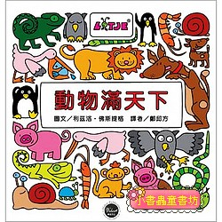
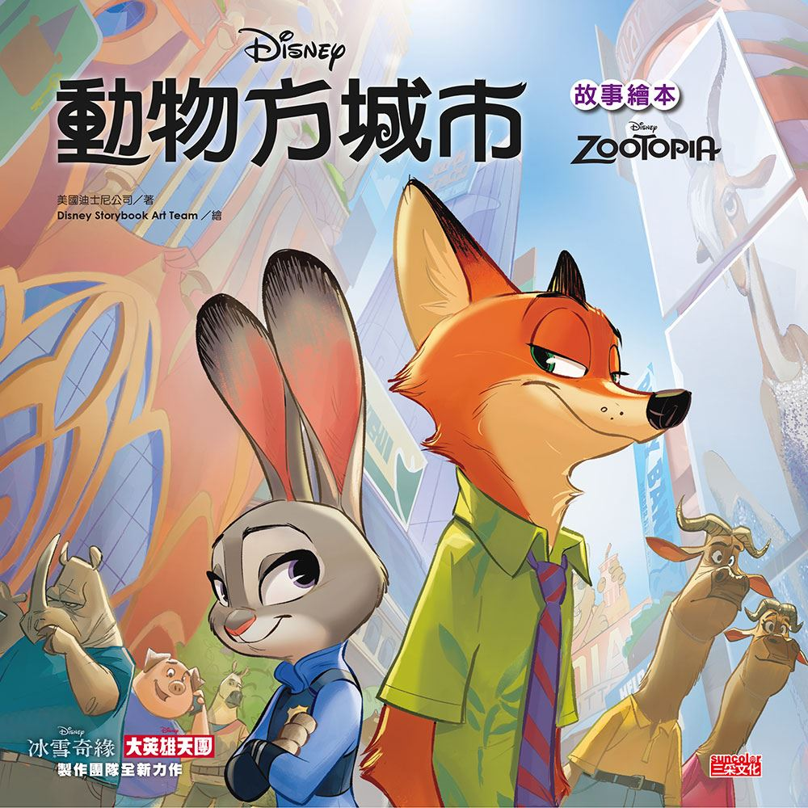
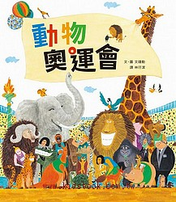

Personalized book search results based on recommendation engine
NLP (Dialogue System): Understand the reader's request and return the books needed by the reader
68% of students increased their reading frequencies with gamified learning (Li, Mok, Cheng & Chu 2018); students are more engaged in reading if the materials are accessible and interesting (Swaggerty, 2015)
Figures source of children’s books ：
・Animal Family http://168.topec.com.tw/Parten/Structural04/goods.asp?p=201507030005&PG_ID=SHOP_05
・Animals are Everywhere https://www.kidsbook.com.tw/books/view_book.asp?id=9738
・Animal Olympics https://www.kidsbook.com.tw/books/view_book.asp?id=8974
・Zootopia https://www.suncolor.com.tw/BookPage.aspx?bokno=112090301002
・Little mouse’s performance day https://www.kidsbook.com.tw/books/view_book.asp?id=9497
According to your keyword: animals, I recommend these books.
Pick one and start reading!
More...
(over 40 more choices)
Notes:
童書圖片、資料來源：
動物家族 http://168.topec.com.tw/Parten/Structural04/goods.asp?p=201507030005&PG_ID=SHOP_05
動物滿天下 https://www.kidsbook.com.tw/books/view_book.asp?id=9738
動物奧運會 https://www.kidsbook.com.tw/books/view_book.asp?id=8974
動物方城市 https://www.suncolor.com.tw/BookPage.aspx?bokno=112090301002
小老鼠的表演日 https://www.kidsbook.com.tw/books/view_book.asp?id=9497

Slide 15


Users can rate the relevance of book search results to their keyword
Students expressed strong interest in reading because they could learn a wide variety of topics
Figure and information source: ・Animal Family http://168.topec.com.tw/Parten/Structural04/goods.asp?p=201507030005&PG_ID=SHOP_05 ・Animals are Everywhere https://www.kidsbook.com.tw/books/view_book.asp?id=9738 ・Zootopia https://www.suncolor.com.tw/BookPage.aspx?bokno=112090301002 ・Zootopia page https://www.suncolor.com.tw/BookPage.aspx?bokno=112090301001 ・Smiley face http://www.maczapp.com/emojis-pro
The Tale of Peter Rabbit
Author: Beatrix Potter
Story Description: This tale follows the naughty child Peter Rabbit as he is chased about the garden of Mr. McGregor. He escapes and returns home to his mother, who puts him to bed....
Reading Age: Suitable for ages 5 and older
Do you think this book is interesting？
□ Interesting □ Average □ Not interesting
Does this book suit your needs？ □ Definitely □ Average □ No
Cumulative Data Feedback Loop allows continuous content optimization and personalized content
Notes:
Relevance
相關性評分
圖片、資料來源：
動物家族 http://168.topec.com.tw/Parten/Structural04/goods.asp?p=201507030005&PG_ID=SHOP_05
動物滿天下 https://www.kidsbook.com.tw/books/view_book.asp?id=9738
動物方城市 https://www.suncolor.com.tw/BookPage.aspx?bokno=112090301002
動物方城市內頁 https://www.suncolor.com.tw/BookPage.aspx?bokno=112090301001
Add by franky:
Cloud storage collect streaming data, establish user profile and do online recommendation training

Slide 16

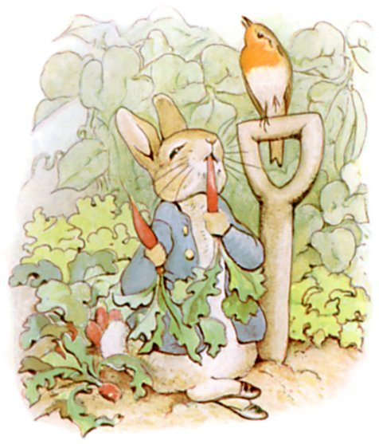
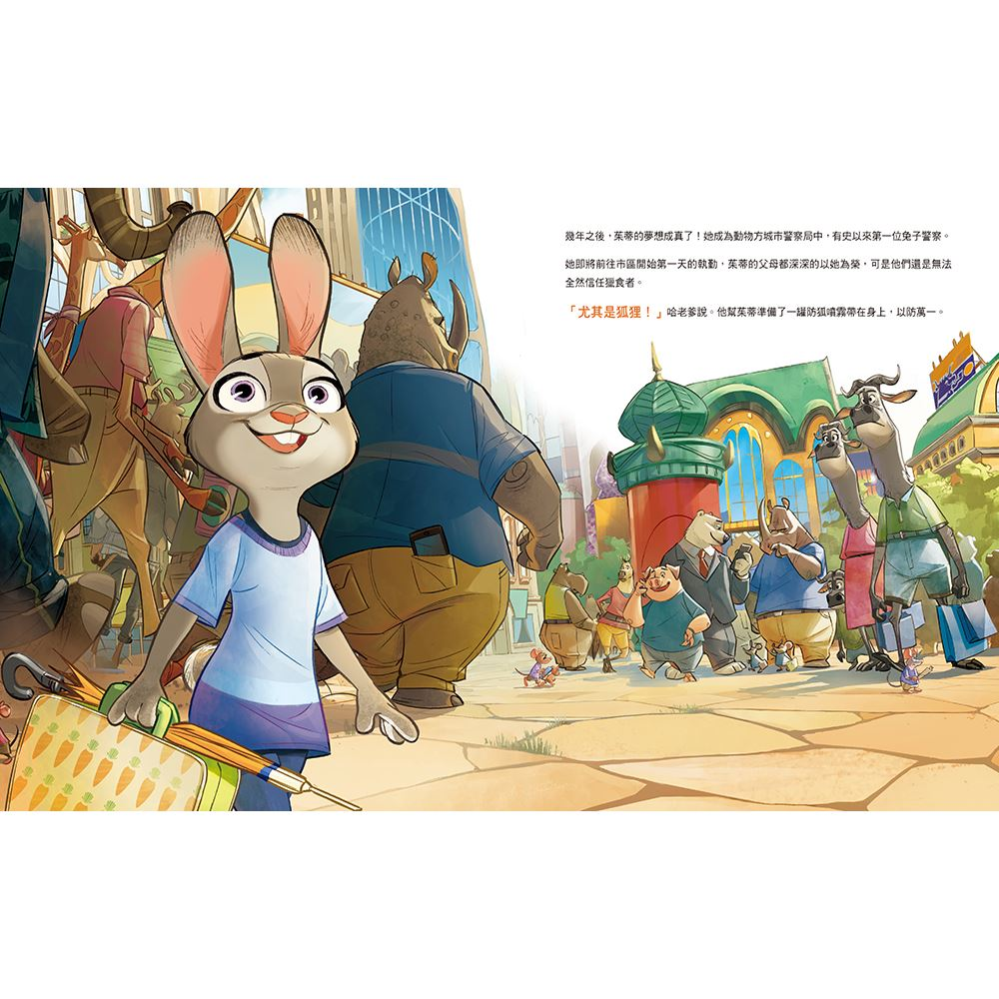
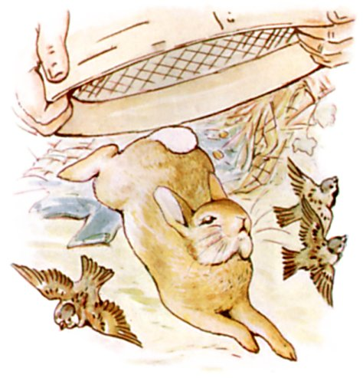




If reading tracking or speech recognition detects decelerated reading speed, the AI robot will appear and offer help to the user
Use of AI in second language learning could improve (reduce?) students’ typical errors by 83 % (Dodigovic, 2007).
Do you need help?
I don’t know how to read this word.
Would you like me to read it for you?
Yes please, thanks!
TensorFlow Lite (run inside mobile app): adapt expert learning models to real-time detect reading difficulty and provide necessary intervention and help.
Please highlight the word or sentence and then press the speaker icon.
(User does as instructed)
007，you seem to be reading more slowly，is there anything I can help?
Notes:
Study background (Dodigovic, 2007): Intelligent tutoring system.
Student tasks: type sentences into text boxes
AI: identify errors and suggest ways to improve or 'solutions' (the correct sentence form)
圖片來源：
滑鼠指針 http://www.shejiye.com/index.php?m=content&c=tag&a=lists&tag=%E6%8C%87%E9%92%88
動物方城市 https://www.suncolor.com.tw/BookPage.aspx?bokno=112090301002
聲音鍵 http://www.dazegraffiti.com/2013/01/blog-post.html
麥克風 https://www.dreamstime.com/stock-illustration-studio-radio-microphone-vector-illustration-isolated-white-background-music-flat-style-image68254603

Slide 17



Research shows that 92 % of students reported improvement in Chinese and English reading and writing under gamification (Li, Mok, Cheng & Chu 2018), and it is very likely that this feature will help students improve their speaking ability, reduce their frustrations, and keep students engaged. This addresses the lack of instant feedback in speech training.
Gamification of Speech Training
Incentives to make progress fun and interesting
Provide numerical comparison and evaluation of users’ pronunciation to that of native speaker’s (e.g. progress bar)
Provide achievement awards, stickers, discounts and other incentives when certain milestones are met
Peter never stopped running or looked behind him till he got home to the big fir-tree.
007 you are awarded 65% for this page. The pronunciation of some vocabulary can be improved. Listen to how a native reads it and challenge it again!
(Page read out by the user)
Great job! You have achieved 85%. You win a Silver Star Achievement!
TensorFlow (google cloud machine learning engine): Analyze reading behavior (duration/ face expression/ eye movement, etc.) with book content , establish a user profile, and provide personalized recommendations based on readers' interests (illustration and text recommendation ).
Star achievement ranking
70%+
80%+
90%+

Slide 18




Leaderboards and Constructive Competition
Contribute leaderboard result to big data and build user profile?
Pronunciation scores and other fluency measuring metrics can be combined into challenges and competitions among public and private groups so users can compare with other users and even share the results to social media accounts
Students are attracted to the gamified platform and are strongly motivated by gaining a good score and rank on the leaderboard. They experience a sense of achievement and often read more books out of their own initiative
(49% of students were deeply engaged in gamified learning drive by a sense of achievement, and 62% of students explicitly credited the leaderboard for their engagement)
(Li, Mok, Cheng & Chu 2018)
E.g. After finishing a certain proportion of challenges, users would be awarded medals or badges of their relevant level. Occasionally, book discounts might be awarded.
According to our own and others’ research, gamified learning can boost learning motivations and achieve more effective learning.
(Chu 2014; Chan, Chu, & Mok 2015; Chan, Chu, Mok & Tam, 2016)
Challenge for The Tale of Peter Rabbit completed. 007,congratulations, you are awarded a score of 85 and a bronze medal!
Leader board
Challenger | Score | Rank
Andrea | 90 | 1
Matt | 88 | 2
007 | 85 | 3
JJ | 80 | 4
Leaderboards to compete with others in skill improvements
Competitions or tournaments between users of similar ability levels
Share your results!
Notes:
圖片 皇冠 https://www.google.com.hk/url?sa=i&source=images&cd=&cad=rja&uact=8&ved=2ahUKEwjVgZyQ1sXcAhUBV7wKHRkIA3kQjRx6BAgBEAU&url=http%3A%2F%2F588ku.com%2Fimage%2Fwangyehuangguan.html&psig=AOvVaw15dwQN-25DXhcBW_9Ir5Ik&ust=1533000510593019
銅牌 https://www.dreamstime.com/stock-illustration-bronze-medal-winners-tape-vector-illustration-image47332371
游戏化学习参考文献
Chu, S. (2014). Developing 21st century skills with plagiarism-free inquiry learning, collaborative teaching, social media, and gamification. Learning and Teaching Expo.
Chan, M. & Chu, S. & Mok, S. & Tam, F. (2016). Fostering interest in reading and strengthening reading comprehension ability of primary school students using a children’s literature e-quiz bank on the cloud.
Chan, M. & Chu, S. & Mok, S. (2015). Fostering interest in reading and strengthening reading comprehension ability of primary school students using a children’s literature e-quiz bank on the cloud. Paper presented at the Quality Education Fund Project Seminar: Learning through Gamification: Cultivating a Love of Reading in Primary Students, The University of Hong Kong, Hong Kong, June 30, 2015.

Slide 19
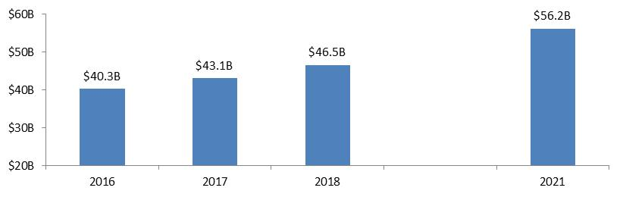



Addressing a Large and Growing Market Opportunity
Global Language Services Industry (US$B)
6% CAGR
Stage 1 Market Evaluation – USA
Increasing demand for Chinese immersion schools in the US
Increasing demand for Chinese lessons
Potentially 1-Million+ Strong!
Increasing number of Chinese immersion schools → 147 in 2013 to 255 in 2018
Spread throughout 31 states and Washington DC
Levels range from preschool to Grade 8
All states (except South Dakota) and Washington DC all have Chinese courses
Chinese is the fourth most studied language in American schools
>227,000 American students study Chinese
Former president Barack Obama advocated Chinese learning and set the goal of 1 million American Chinese learners by 2020
Source: Statista 2018; S-China Strong Foundation (n.d.), Xinhua (2017), Weise (2013)
Figure source: https://www.cfr.org/blog/michelle-obamas-china-choice-public-diplomacy-vs-politics

Slide 20



Business Expansion Plan
Many governments initiated Chinese learning educational policies
Canada
UK
USA
Stage 1
Hong Kong Base
Targeting 500 students from 10 different primary schools
Brazil
Australia
New Zealand
Source: Australian Government (2012), Education Gazette Editors (2017), Farah (2013), Malley (2016), The British Council, (2017), US-China Strong Foundation (n.d.) Ye (2014)
Figure source: www.flaticon.com

Slide 21


Business Model
Target customers
Schools
Libraries
Individuals
Revenue Model
Revenue model
Subscription packages
Multi-user subscription packages for schools and libraries
Offer access to certain number of books per month or year
Individual subscriptions for single users
Direct retail sales of individual books
・Publish articles on online newspapers or platforms
(e.g. OhPaMa）
・Cooperate with learning companies（e.g. eFunLearning Ltd. ）
・Advertise on social media platforms
・Cooperate with education-oriented YouTubers
Figure source: www.flaticon.com
Notes:
OhPaMa - http://www.ohpama.com/ (親子網路平台，供家長、老師分享育兒資訊)

Slide 22






Competitive
Analysis
 | SmartBookTM | International Children's Digital Library (ICDL) | Asia for Kids | East West Discovery Press | Pan Asian Publications
Application of artificial intelligence
E-books |  |  |  |  | Sell a single/Bilingual eBook through Amazon
Printed books
Online platform
Application | iOS and android | iOS only
Source: http://en.childrenslibrary.org/; https://itunes.apple.com/us/app/icdl-free-books-for-children-international-childrens/id363731638?mt=8; http://en.childrenslibrary.org/; http://www.afk.com/; http://www.eastwestdiscovery.com/bookstore.asp; http://www.panap.com/home Figure source: www.flaticon.com
Notes:
??Expand
??Online Platform and Apps

Slide 23

Financials
Revenue / Expenses (HKD) | Month
 | 1-3 | 4-9 | 10-15 | 16-21 | 22-27 | 28-33
Total ebook sales | 0 | 3,450 | 32,337 | 156,082 | 753,379 | 3,636,418
Income from library subscriptions | 0 | 126,000 | 495,000 | 1,035,000 | 1,575,000 | 2,115,000
Total sales | 0 | 129,450 | 527,337 | 1,191,082 | 2,328,379 | 5,751,418
Wages | 375,000 | 750,000 | 768,750 | 787,500 | 810,548 | 826,875
Expenses on technical aspects | 183,000 | 347,000 | 252,000 | 195,000 | 138,000 | 138,000
Marketing expenses | 15,000 | 30,000 | 40,000 | 42,000 | 34,000 | 30,000
Facilities expenses | 59,000 | 6,000 | 6,000 | 42,000 | 6,000 | 6,000
Total expenses | 632,000 | 1,133,000 | 1,066,750 | 1,066,500 | 988,548 | 1,000,875
Total revenue | -632,000 | -1,003,550 | -539,413 | 124,582 | 1,339,832 | 4,750,543
Net balance | -632,000 | -1,635,550 | -2,174,963 | -2,050,381 | -710,549 | 4,039,994
Notes:
圖片來源：
https://www.google.com.hk/url?sa=i&source=images&cd=&cad=rja&uact=8&ved=2ahUKEwj3lPOixsncAhWOAYgKHXwVCvkQjRx6BAgBEAU&url=http%3A%2F%2Fwww.seinsights.asia%2Farticle%2F3291%2F3280%2F3578&psig=AOvVaw375uCxVX5STlwZXD0XlItb&ust=1533133702220603

Slide 24


Milestones
 | Stage1: Prototype (Month 1-8) - | Stage 2: Soft launch (Month 9-18) - | Stage 3: Large-scale launch (Month 19-33) -
System and mobile application development | Platform design Development of system and main platform (verbal interaction platform) Interface design Recommended system Feasibility study (launch evaluation and feasibility test) Test and fine-tune the prototype and initial design Platform is ready for alpha launch in June 2019 (month 8 of business plan) | Further implement big data and AI features to quantify user reading abilities Integrate alpha user feedback to perfect the mobile application and platform Fine-tune recommendation engine based on user feedback and alpha test data | Prepare for Beta launch Integrate speech and pronunciation listening features with application and recommendation engine Implement personalized “Self Adapted Learning System” for individual users to customize user learning path through content library Add gamification features (e.g. challenges, leaderboards, etc.)
Content development | Content development of eBooks 100 English children’s classics 100 Traditional Chinese Fables and poems Audio capabilities available for all ebooks | Expand book trove to 200 English children’s classics 200 Traditional Chinese Fables and poems Big data collection from major users | Expand book trove to 500 English children’s classics 500 Traditional Chinese Fables and poems
Finances and investment | Raise US$100-200K | Raise additional US$150-300K | - Raise additional US$200-400K - Breakeven

Slide 25
Sources:
Amin, J. (2015). Beginner ’s Guide to Character Creation in Maya Index Terms are not available. 3dtotal Publishing.
Australian Government. (2012). Australia in the Asian Century.
Balyan, R., Mccarthy, K. S., & Mcnamara, D. S. (2017). Combining Machine Learning and Natural Language Processing to Assess Literary Text Comprehension, (June), 244–249.
Chan, M. & Chu, S. & Mok, S. & Tam, F. (2016). Fostering interest in reading and strengthening reading comprehension ability of primary school students using a children’s literature e-quiz bank on the cloud.
Chan, M. & Chu, S. & Mok, S. (2015). Fostering interest in reading and strengthening reading comprehension ability of primary school students using a children’s literature e-quiz bank on the cloud. Paper presented at the Quality Education Fund Project Seminar: Learning through Gamification: Cultivating a Love of Reading in Primary Students, The University of Hong Kong, Hong Kong, June 30, 2015.
Chan, W., Jaitly, N., Le, Q., & Vinyals, O. (2016, March). Listen, attend and spell: A neural network for large vocabulary conversational speech recognition. In Acoustics, Speech and Signal Processing (ICASSP), 2016 IEEE International Conference on (pp. 4960-4964). IEEE.
Chen, X.Y., Li, X.H., Lee, S.Y.C., & Chu, S.K.W. (2018). Re-examining students’ reading experience in a gamified context from a self-determination perspective: A multiple-case study. ASIS&T 2018, November 10-14, 2018, Vancouver, Canada.
Chu S., Clancy E., Van G. W. F. (2018) Stimulating reading in primary school children with an online gamified reading challenge. Submitted to Learning and Instruction.
Chu, S. (2014). Developing 21st century skills with plagiarism-free inquiry learning, collaborative teaching, social media, and gamification. Learning and Teaching Expo.
Dipardo, A., & Schnack, P. (2004). Expanding the web of meaning: Thought and emotion in an intergenerational reading and writing program. Reading Research Quarterly, 39(1), 14–37. http://doi.org/10.1598/RRQ.39.1.3
Education Gazette Editors. (2017). Early start on Mandarin opens doors to wider world. Aoteoroa New Zealand Education Gazette, 96(15).
Farah, A. G. V. (2013, May 13). The value of a second language in Brazil. The Brazil Business,.
Gupta, M. R., Jacobson, N. P., & Garcia, E. K. (2007). OCR binarization and image pre-processing for searching historical documents. Pattern Recognition, 40(2), 389–397. http://doi.org/10.1016/j.patcog.2006.04.043
Gwizdka, J. (2017). Information Systems and Neuroscience, 16. http://doi.org/10.1007/978-3-319-41402-7
Hicsonmez, S., Samet, N., Sener, F., & Duygulu, P. (2017). DRAW: Deep networks for Recognizing styles of Artists Who illustrate children’s books. In Proceedings of the 2017 ACM on International Conference on Multimedia Retrieval (pp. 338–364).

Slide 26
Lichtenfeld, S., Pekrun, R., Stupnisky, R. H., Reiss, K., & Murayama, K. (2012). Measuring students’ emotions in the early years: The Achievement Emotions Questionnaire-Elementary School (AEQ-ES). Learning and Individual Differences, 22(2), 190–201. http://doi.org/10.1016/j.lindif.2011.04.009
Li, X.H., Mok, S.W., Cheng, Y.Y.J., & Chu, S.K.W. (2018). An examination of a gamified e-quiz system in fostering students’ reading habit, interest and ability. Paper to be presented at the ASIS&T 2018 Annual Meeting, Vancouver, Canada.
Malley, A. (2016). Why learning Chinese should be compulsory in Australian schools. The Sydney Morning Herald.
Ming, Y. (2015). Robust regional bounding spherical descriptor for 3D face recognition and emotion analysis. Image and Vision Computing, 35, 14-22.
Ono, Y., Onishi, A., Ishihara, M., & Yamashiro, M. (2015). Voice-Based Computer Mediated Communication for Individual Practice to Increase Speaking Proficiency: Construction and Pilot Study. In Learning and Collaboration Technologies (pp. 115-123). Springer, Cham.
Pekrun, R., & Linnenbrink-garcia, L. (2012). Academic Emotions and Student Engagement. In Handbook of Research on Student Engagement. http://doi.org/10.1007/978-1-4614-2018-7
Sariyanidi, E., Gunes, H., & Cavallaro, A. (2015). Automatic analysis of facial affect: A survey of registration, representation, and recognition. IEEE transactions on pattern analysis and machine intelligence, 37(6), 1113-1133.
Swaggerty, E. A. (2015) Selecting Engaging Texts for Upper Elementary Students Who Avoid Reading or Find Reading Difficult. In D. A. Wooten & B. E. Cullinan (Eds.), Children’s Literature in the Reading Program: Engaging Young Readers in the 21st Century. International Literacy Association.
The British Council. (2017). Languages for the Future.
US-China Strong Foundation. (n.d.). 1 million strong. Retrieved from http://uschinastrong.org/initiatives/1-million-strong/
Vega, M. (1996). The Representation of Changing Emotions in Reading Comprehension. Cognition & Emotion, 10(3), 303–322. http://doi.org/10.1080/026999396380268
Weise, E (2013) Mandarin immersion schools in the United States in 2014. Retrieved from https://miparentscouncil.org/2013/11/20/mandarin-immersion-schools-in-the-united-states-in-2014/#_edn1
World Intellectual Property Organization. (n.d.-a). Summary of the Berne Convention for the Protection of Literary and Artistic Works (1886). Retrieved from http://www.wipo.int/treaties/en/ip/berne/summary_berne.html
Xinhua (2017) Interview: American students learning Mandarin reach 400,000: U.S. program head. Retrieved from http://www.xinhuanet.com/english/2017-08/28/c_136559843.htm
Ye, J. (2014, September 29). Mandarin prospers in Brazil.
Yin J, Lee SYC, Lee M , Chu KWS The Academic Impacts of Oxford Achiever on Hong Kong Primary School Students: A Self-determination Case Study. Paper to be presented at the ASIS&T Regional Conference 2019, Phnom Penh, Cambodia.

Slide 27
Figure source:
Michelle Obama - https://www.cfr.org/blog/michelle-obamas-china-choice-public-diplomacy-vs-politics
Peter Rabbit: http://www.cybercrayon.net/readingroom/books/bp-peterrabbit/peterrabbit.html
The Secret Garden: https://www.google.com/url?sa=i&rct=j&q=&esrc=s&source=images&cd=&cad=rja&uact=8&ved=2ahUKEwiP4sGI0YjcAhVB9YMKHXwRB08QjRx6BAgBEAU&url=https://www.amazon.com/Secret-Garden-Frances-Hodgson-Burnett-ebook/dp/B005GWF2ZK&psig=AOvVaw38uXJubsX0pvoT0JUCTkBd&ust=1530903220042453
The Velveteen Rabbit: https://www.google.com/url?sa=i&rct=j&q=&esrc=s&source=images&cd=&cad=rja&uact=8&ved=2ahUKEwiz5dS30IjcAhWRd98KHaq2DlEQjRx6BAgBEAU&url=https://www.oompa.com/products/the-velveteen-rabbit-plush-toy&psig=AOvVaw2qqAeY6kIonYLKp8caSOGU&ust=1530903043247992
OCR image source: http://www.51freeware.com/?tag=%E6%96%87%E5%AD%97%E8%AF%86%E5%88%AB
Other illustrations: http://www.flaticon.com
動物家族 http://168.topec.com.tw/Parten/Structural04/goods.asp?p=201507030005&PG_ID=SHOP_05
動物滿天下 https://www.kidsbook.com.tw/books/view_book.asp?id=9738
動物奧運會 https://www.kidsbook.com.tw/books/view_book.asp?id=8974
動物方城市 https://www.suncolor.com.tw/BookPage.aspx?bokno=112090301002
小老鼠的表演日 https://www.kidsbook.com.tw/books/view_book.asp?id=9497
學漢語 http://www.sohu.com/a/243328187_418353
說故事 http://www.elitian.hk/story-telling-course
聽 http://reader.roodo.com/lhyun123/archives/1263966.html
說 http://wk706.pixnet.net/blog/post/53123413-%E6%98%9F%E6%9C%9F%E5%85%AD%E5%89%B5%E5%88%8A%E8%99%9F%E2%94%80706(%E6%88%91%E6%9C%89%E8%A9%B1%E8%A6%81%E8%AA%AA)
書 https://edonix.it/book-icon-91379-3/
Cursor http://www.shejiye.com/index.php?m=content&c=tag&a=lists&tag=%E6%8C%87%E9%92%88
Speaker icon http://www.dazegraffiti.com/2013/01/blog-post.html
Microphone icon https://www.dreamstime.com/stock-illustration-studio-radio-microphone-vector-illustration-isolated-white-background-music-flat-style-image68254603

